Slide 1
Neurological Disease Detection
Group 5

Slide 2
Table of contents
01
02
03
04
05
06
Research Focus
Project Flow
Data Setup
Existing Literature
Model Reimplementation
Future Steps

Slide 3
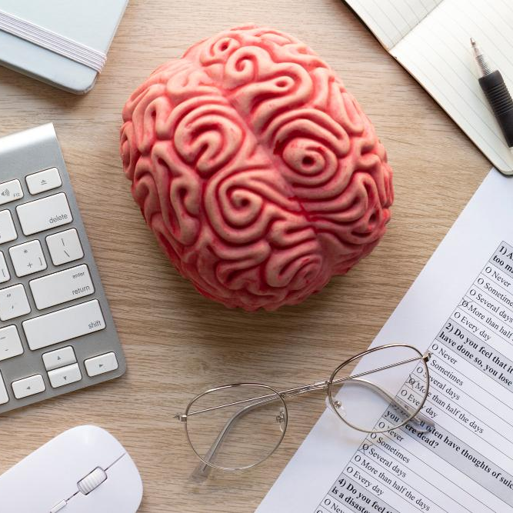
01: Research Focus
Motivation
Objective
Early Detection of Alzheimer and Parkinson is critical given late stage not curable
Handwritings can provide the patient’s current neurologic states
Pick Alzheimer and Parkinson due to sharing characteristics such as tremor
Can be further extended to combination of other diseases
Analyze different deep learning models on its capability to detect Alzheimer or Parkinson
Explore the potential for the interchangeability of these models on detection of existence on both diseases. (i.e. given a handwriting image, can the model correctly predict whether the sample is healthy, Alzheimer patient or Parkinson patient)
Notes:
Hamza

Slide 4
02: Project Flow
Construct multi classification model that outputs:
healthy(0)
Alzheimer(1)
Parkinson(2)
Reimplement Alzheimer & Parkinson from existing research
Combine and reformat dataset to enable detection for both diseases
Notes:
Hamza

Slide 5

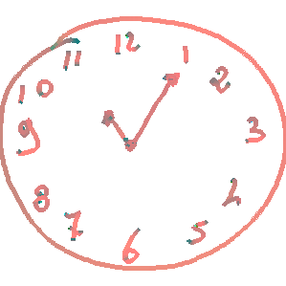
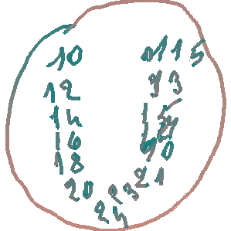
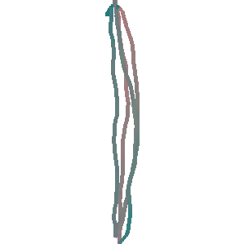
03: Dataset - Alzheimer(DARWIN)
174 participants: 89 diagnosed with Alzheimer’s and 85 healthy
Both 2D image and 1D handwriting data (pen pressure, speed, air time, etc.)
We found handwriting images from 6 out of 25 tasks: we use the 2D colored images → 1009 images
Notes:
Alyssa
Note: images from same healthy person and same alzheimer person

Slide 6
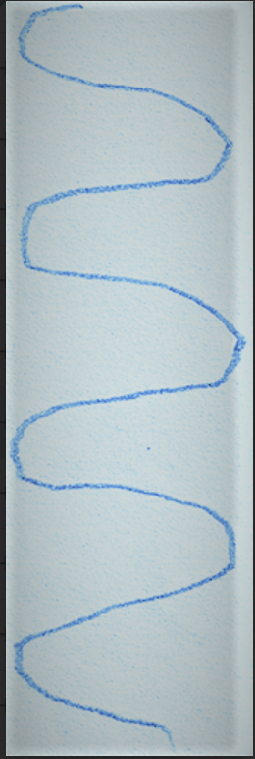
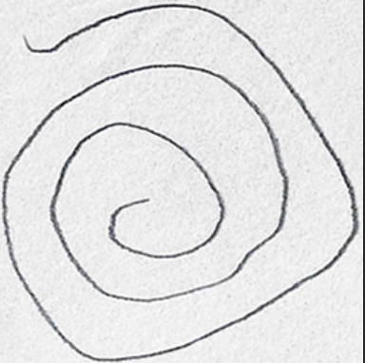
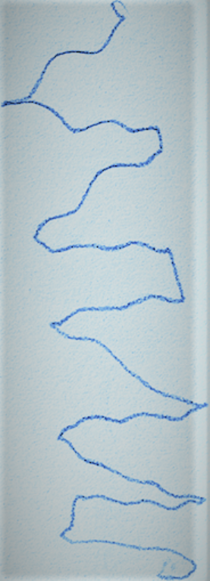
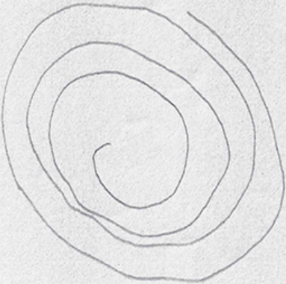
03: Dataset - Parkinson
Healthy
Parkinson Patients
Source from Kaggle, combined HandPD(spirals) and other handwriting images
3264 total samples equally distributed between patients and healthy group
Notes:
Alyssa

Slide 7
03: Dataset - Combined
Random select 60% of each Parkinson dataset
Concatenate with all data used from Alzheimer’s model reimplementation
Total Samples:
  2969: 1009 images from DARWIN and 1960 from Parkinson
  We intentionally kept more healthy images. Even though the sample is identified as healthy, the images are different and we want the model to capture this information
Notes:
Alyssa

Slide 8
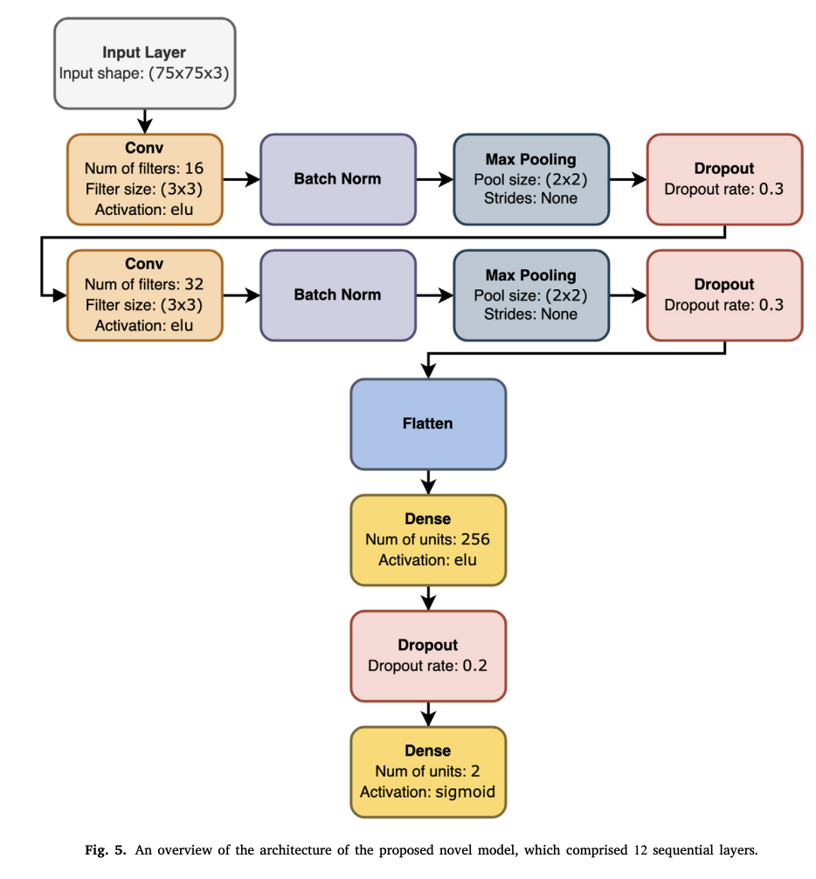
04: Existing Literature- Alzheimer
Current literature focused on taking 1D data and transforming into 2D representation, then modeling on transformed 2D image
12-layer CNN model (Erdogmus & Kabakus, 2023)
DoppelGANger (Dao et al., 2023)
Baseline testing using ResNet50, MobileNetV2, Inception, VGG, DenseNet and other machine learning methods (SVM, boosting methods, etc.)
Notes:
Isabel

Slide 9
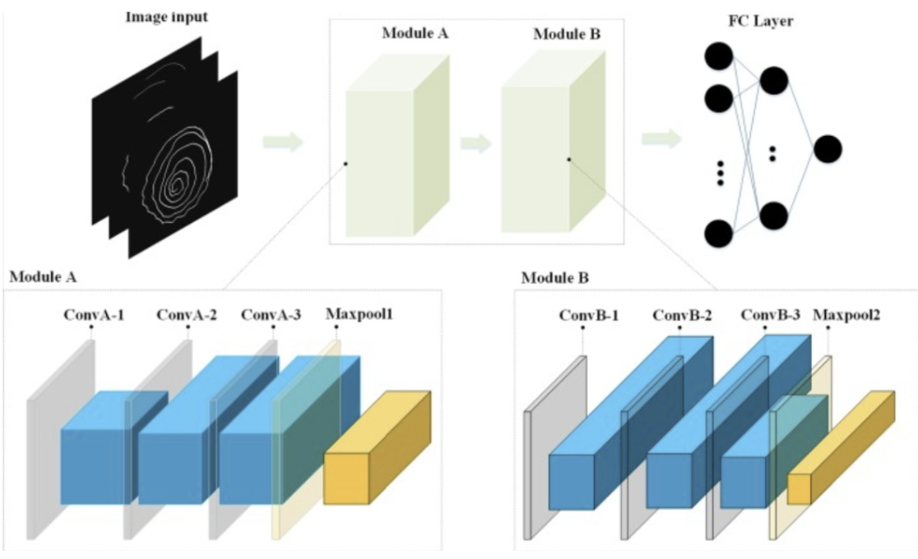
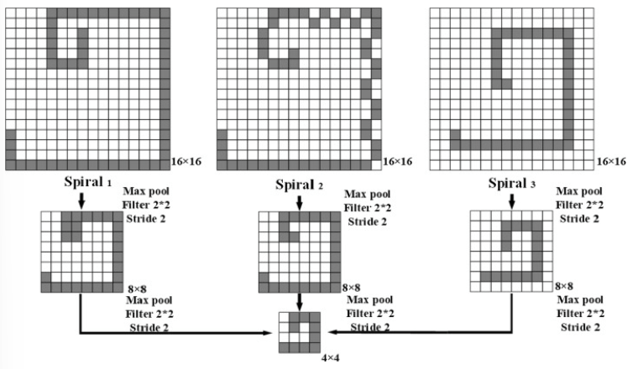
04: Existing Literature - Parkinson
CC-NET + FC
Two-block CNN (Li et al 2022)
Reduce the amount of Max Pooling
Designed based on AlexNet
Ablation Experiment model for preprocessing
Notes:
Alyssa

Slide 10
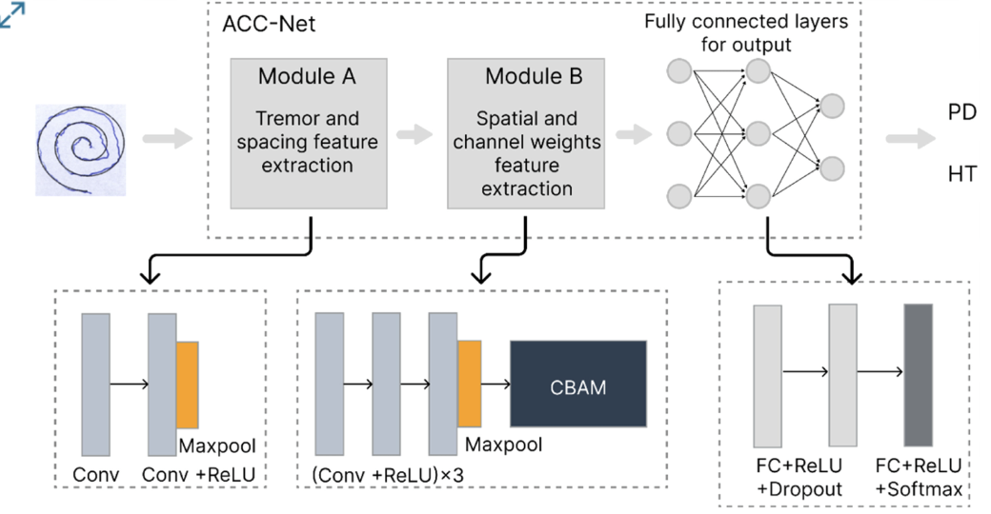
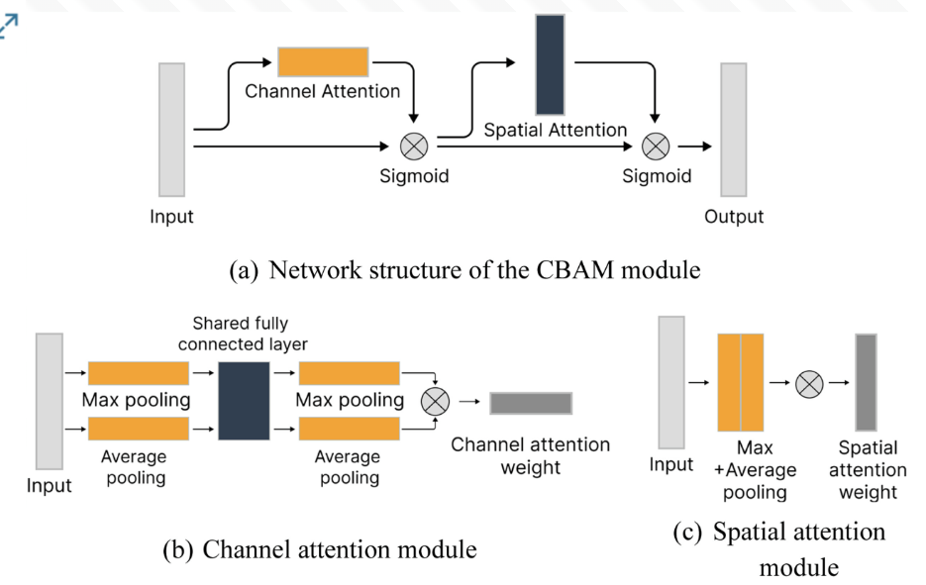
04: Existing Literature - Parkinson
CC-NET + CBAM
Alternative CC-Net (Jiang et al)
CBAM: Convolutional Block Attention
CBAM enables the model to identify the significant regions.
Notes:
Alyssa

Slide 11
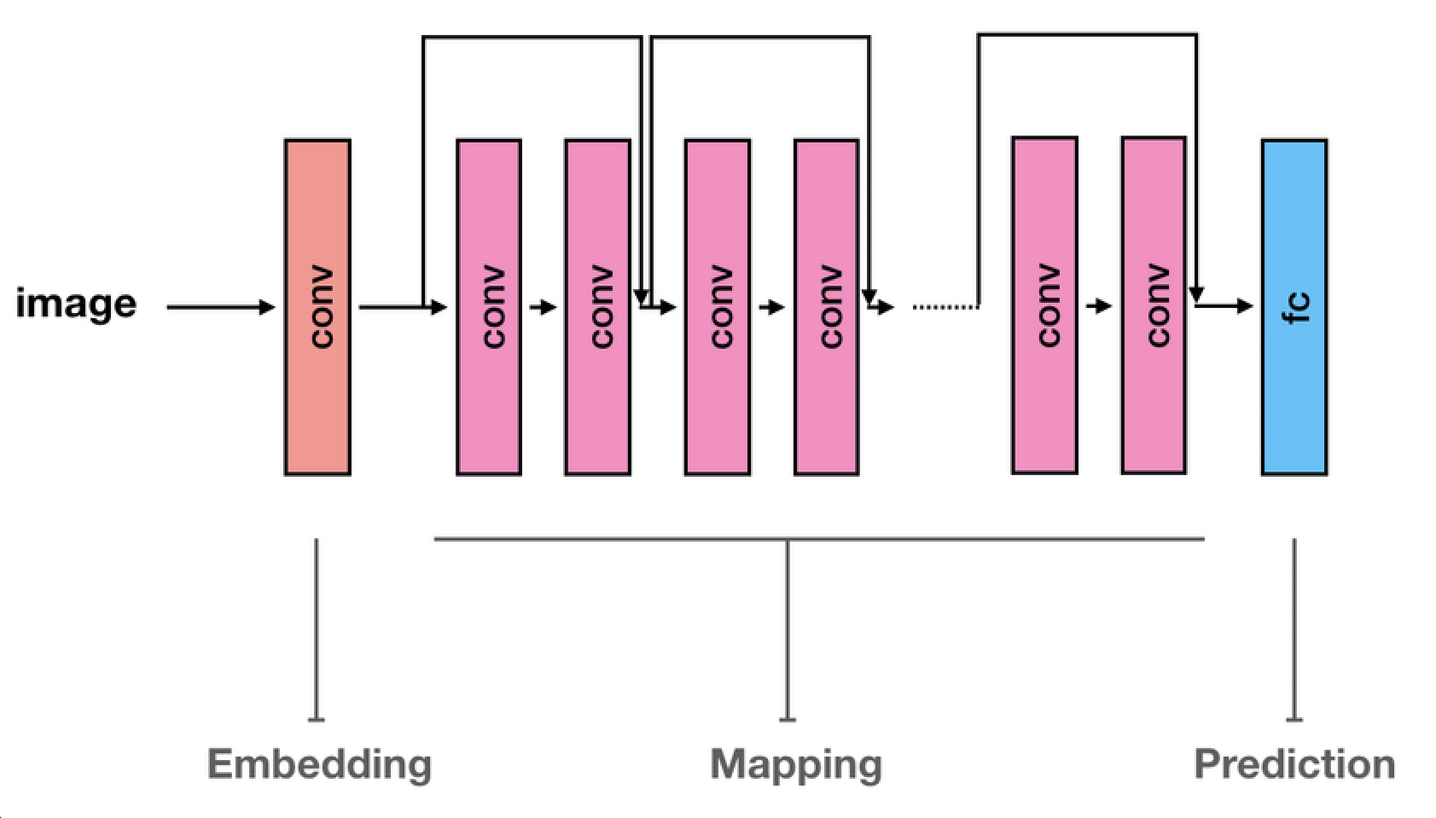
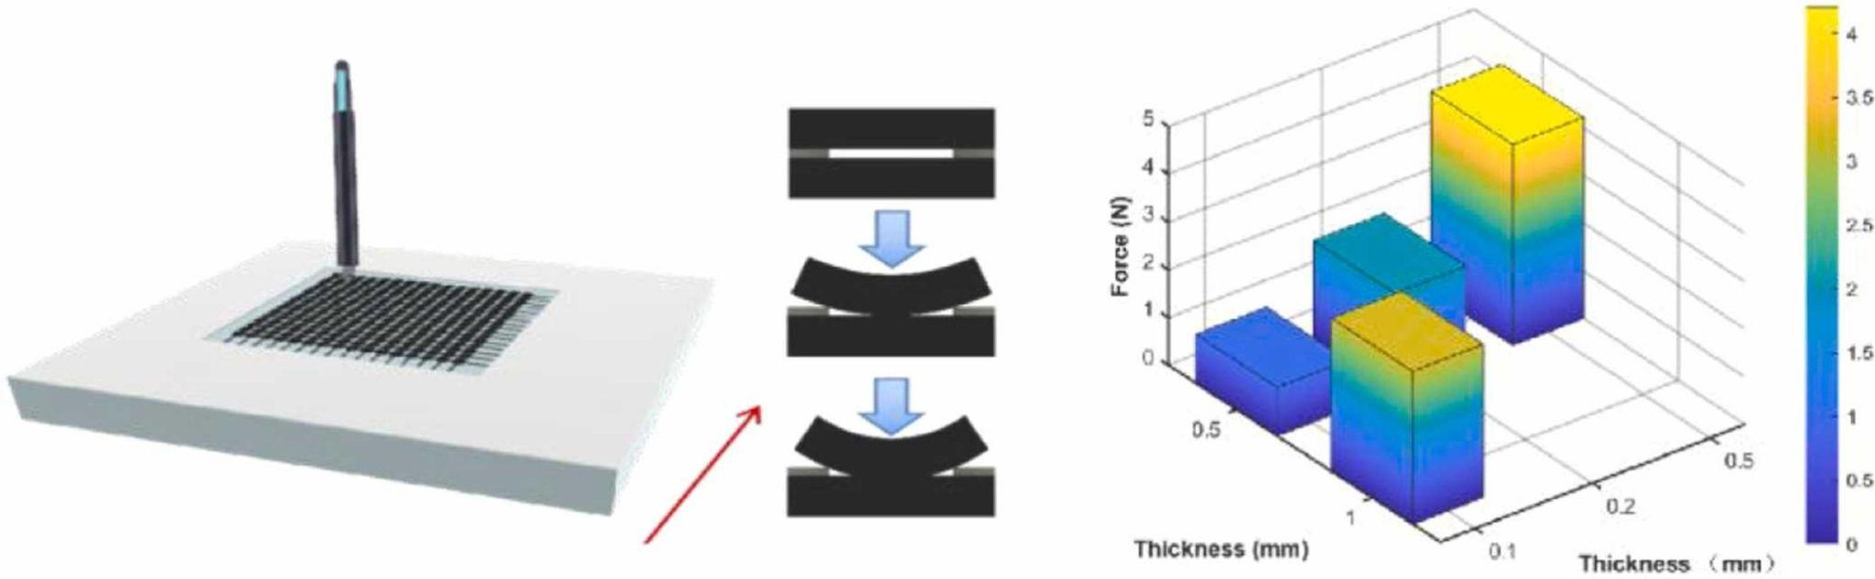
04: Existing Literature - Parkinson
Flexible sensor captures detailed handwriting dynamics.
Deep ResNet architecture extracts subtle, discriminative features.
Could enable early screening in routine or remote settings.
ResNet
Notes:
Deven

Slide 12
05: Model Reimplementation
Alzheimer 2D Tuned Hyperparameters
Conv Drop | 0.3
FC Drop | 0.2
Batch Size | 32
Optimizer | Adam
Loss Fn | Cross entropy
Ln_rate | 1e-3
Re-implementation of 12-layer CNN model on transformed 1D
Select models from the literature applied on original 2D handwriting images
  Baseline include: ResNet50, MobileNetV2, and DenseNet121
  Hyperparameter tuning conducted via 4-fold cross-validation on the 12-layer CNN model
Notes:
Isabel

Slide 13
05: Model Reimplementation
Alzheimer-Only Model Test Performance on Original 2D
 | Avg. Val. Loss | AUC | Accuracy | F1
ResNet50 | 0.7119 | 0.7727 | 0.7303 | 0.7248
MobileNetV2 | 0.7014 | 0.7876 | 0.7368 | 0.7436
DenseNet121 | 0.6053 | 0.7921 | 0.7039 | 0.7097
*CNN 12-layer | 0.6804 | 0.6974 | 0.6634 | 0.7154
Alzheimer-Only Model Test Performance on Transformed 1D
*CNN 12-layer | .6437 | .9497 | 0.9265 | 0.9241
Notes:
Isabel:

Slide 14
05: Model Reimplementation
 | AUC | Accuracy | F1
CC-Net | 0.9905 | 0.9755 | 0.9759
ResNet | 0.9127 | 0.8484 | 0.8480
Parkinson Parameters
Seed | 2025 | Batch Size | 32 | Lossfn | Cross Entropy
Kernel Size | 227 * 227 | Ln_rate | 1e-4 | Optimizer | Adam
Notes:
Alyssa

Slide 15
06: Preliminary Results
Combined Model Performance
 | Classification | Precision | Recall | F1-score
CC-Net Accuracy = 85% | Healthy | 0.83 | 0.88 | 0.85
 | Alzheimer | 0.70 | 0.58 | 0.63
 | Parkinson | 0.92 | 0.90 | 0.91
ResNet Accuracy = 81% | Healthy | 0.82 | 0.80 | 0.81
 | Alzheimer | 0.60 | 0.90 | 0.72
 | Parkinson | 0.91 | 0.81 | 0.86
MobileNetV2 Accuracy = 90% | Healthy | 0.89 | 0.90 | 0.89
 | Alzheimer | 0.69 | 0.75 | 0.72
 | Parkinson | 0.98 | 0.95 | 0.97
Notes:
Deven

Slide 16
06: Next Steps
Refine existing models via imbalance-aware training
  Fine-tune models using techniques like class-weighting, and sampling strategies
Tune and strengthen baselines architectures
  Improve baseline models through structured parameterization and robust variable
Optimize models on the combined AD-PD dataset
  Continue developing models on combined Alzheimer and Parkinson data to identify architectures that generalize well across tasks and disease types.
Design hybrid model for cross-disease detection
  Construct and evaluate a new model that integrates strengths of multiple models to create optimized framework
Notes:
Deven

Slide 17
Reference
B. Anil Kumar, & Mohan Bansal. (2023). A Transfer Learning Approach with MobileNetV2 for Parkinson’s Disease Detection using Hand-Drawings. IEEE. https://doi.org/10.1109/ICCCNT56998.2023.10307641
Erdogmus, P., & Kabakus, A. T. (2023). The promise of convolutional neural networks for the early diagnosis of the Alzheimer’s disease. Engineering Application of Artificial Intelligence, 123. https://doi-org.libproxy.lib.unc.edu/10.1016/j.engappai.2023.106254
Jiang, X., Yu, H., Yang, J., Liu, X., & Li, Z. (2025). A new network structure for Parkinson’s handwriting image recognition. Medical Engineering and Physics, 139. https://www-clinicalkey-com.libproxy.lib.unc.edu/#!/content/1-s2.0-S1350453325000529?scrollTo=%23hl0000729
Li, Z., Yang, J., Wang, Y., Cai, M., Liu, X., & Lu, K. (2022). Early diagnosis of Parkinson’s disease using Continuous Convolution Network: Handwriting recognition based on off-line hand drawing without template. Journal of Biomedical Informatics, 130. https://doi-org.libproxy.lib.unc.edu/10.1016/j.jbi.2022.104085
Yue Zhang, Haifeng Lin, Xiangjie Xie, Peng Peng, Ting Chen, Zhenhua Zhao, Yuxing Wen, & Wenyao Hong. (2025). A novel approach for handwriting recognition in Parkinson’s disease by combining flexible sensing with deep learning technologies. Sensors and Actuators A: Physical, 385. https://doi-org.libproxy.lib.unc.edu/10.1016/j.sna.2025.116287

Slide 18
Thank you!
Q&A

Slide 19
Instructions for use
If you have a free account, in order to use this template, you must credit Slidesgo by keeping the Thanks slide. Please refer to the next slide to read the instructions for premium users.
As a Free user, you are allowed to:
Modify this template.
Use it for both personal and commercial projects.
You are not allowed to:
Sublicense, sell or rent any of Slidesgo Content (or a modified version of Slidesgo Content).
Distribute Slidesgo Content unless it has been expressly authorized by Slidesgo.
Include Slidesgo Content in an online or offline database or file.
Offer Slidesgo templates (or modified versions of Slidesgo templates) for download.
Acquire the copyright of Slidesgo Content.
For more information about editing slides, please read our FAQs or visit our blog:
https://slidesgo.com/faqs and https://slidesgo.com/slidesgo-school

Slide 20
Educational Icons
Medical Icons

Slide 21


